Slide 1
A new strategic plan
Notes:
I’m listening – and open to other questions

Slide 2
Why have a plan?
Notes:
Introduction from Peter

Slide 3
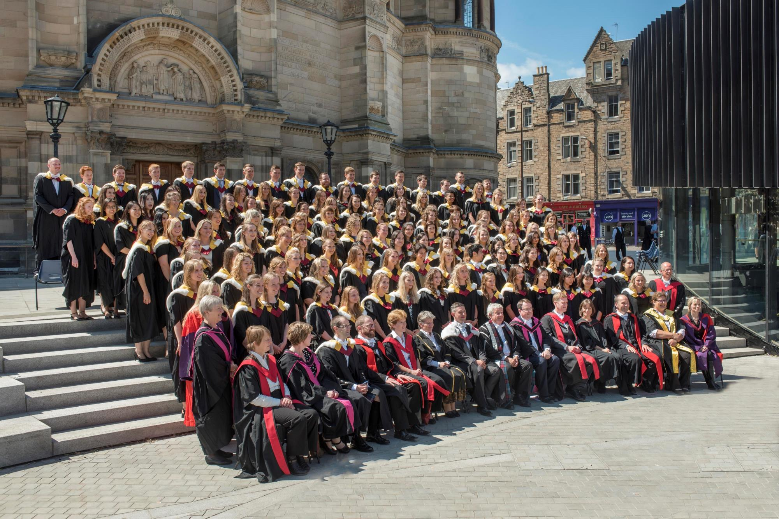
Values
A people-organisation – making the world a better place
Deliver excellence with principles
Inclusive, accessible and relevant to all
Caring, cherishing, celebrating achievements
We are Edinburgh
One University
Notes:
Why we’re doing what we do
Option 1 – brief bullets

Slide 4
Strategic priorities
Through our teaching, research and knowledge exchange we will:
Effectively address tomorrow’s greatest challenges
Build a People-focused culture which cherishes students, staff, alumni & friends and nurtures a sense of community, efficiency and openness
Be recognised as a destination of choice for students and staff from Scotland and all over the globe
Notes:
What we will do

Slide 5
FOCUSING ASPIRATIONS
Scottish university, global outreach, international partnerships
Attract and retain best students and staff
Invest in excellence – we will not grow for growth’s sake
Data Driven Innovation – Data Capital of Europe
Porous boundaries with industry, government
Building public trust in ethical use of data
Celebrate critical thinking
All our graduates making a difference
Effective and person-focused digital systems and processes
Notes:
How we will deliver the plan
Option 2: minimal text

Slide 6
We all need to play a part
Notes:
Further consultations etc

Slide 7
Holding ourselves to account
Notes:
We will be specific: not only aspiring, but stating how we will deliver on our aspirations.

Slide 8
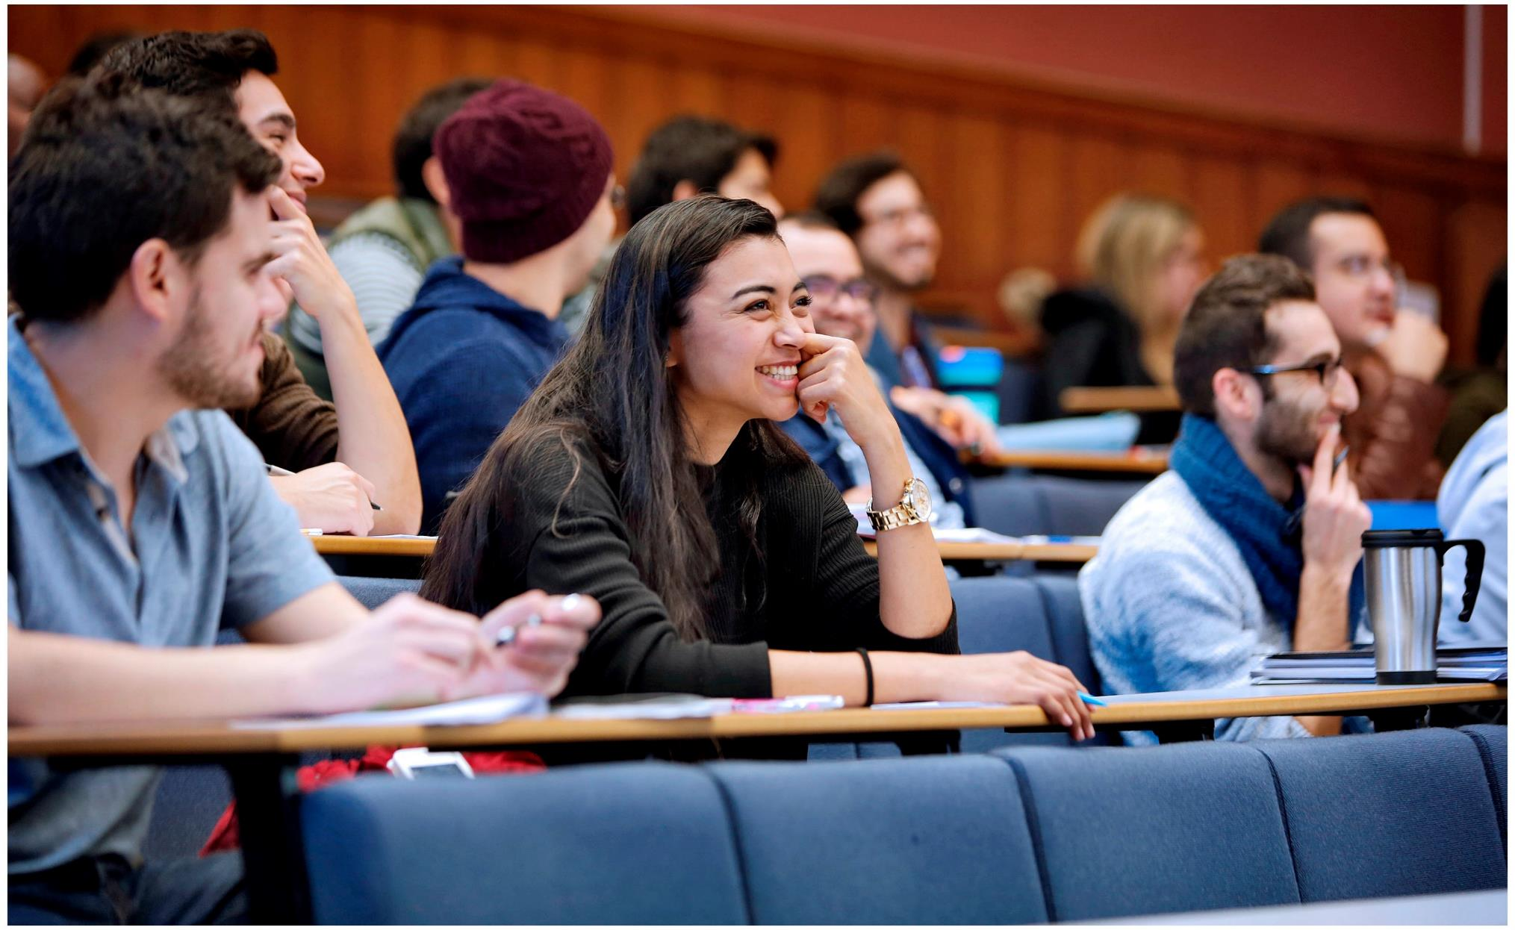
Get involved
www.ed.ac.uk/strategicplan/2019
strategic.plan@ed.ac.uk
Notes:
Not just the senior management plan.

